Slide 1
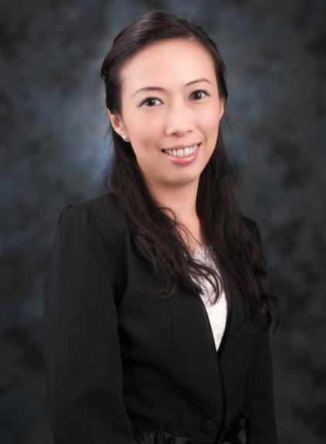
嶄新的公司：化繁為簡的致勝策略
A New Company: Keeping the UnFranchise™ Business Simple
Veronica Ng
業務拓展及傳訊經理 Sales & Communications Manager

Slide 2
化繁為簡及提升
Simplify & Improve

Slide 3
持續令招募、推薦及發展事業變得更簡單的程序和計劃
Ongoing process and plan of making it faster and easier to recruit and retail to grow our business.

Slide 4
成功五要訣
Basic 5

Slide 5
產生效益的活動
使用及銷售產品
宣傳事業
賣票
在家工作
Result Producing Activities
Use and sell the Products
Introducing the Business
Sell Tickets
Work in the homes

Slide 6
All
總值
HK$3,655
VALUE
你一定要有的3張門票！
it
takes
“I Got My 3”禮品：
Isotonix® OPC-3®
Frusanté®活心果茶一瓶
美安香港網路中心 mhk WebCenters™
3
is

Slide 7
化繁為簡的各項措施：
快速起步套裝（基本、Motives®、TLS®健康生活纖營計劃、 網路中心）
全新UBP簡報
立即加入 / 等候室 (Waiting Room)
自動年度續約
Accomplishments to simplify the business:
Fast Start program (General, Motives®, TLS®, Webcenter)
New UBP PowerPoint presentation
Partner Now / Waiting Room
Auto Annual Renewal

Slide 8
化繁為簡的各項措施：
自動購貨產品預設
自動送貨
全新簡化起步窗口
全新簡化入會窗口
Accomplishments to simplify the business:
Transfer buying autofill
Autoship
New, simplified Getting Started Wizard
New, simplified Sign Up Wizard

Slide 9
化繁為簡的各項措施：
產品組合套裝
網上兌換券
1000表格提交截止時間11:59pm
Accomplishments to simplify the business:
Product kits
Online vouchers
Form 1000 – 1:59pm → 11:59pm

Slide 10
還可變得更好嗎？
Can it get any better?

Slide 11
自動提交1000表格
Automatic Form 1000

Slide 12
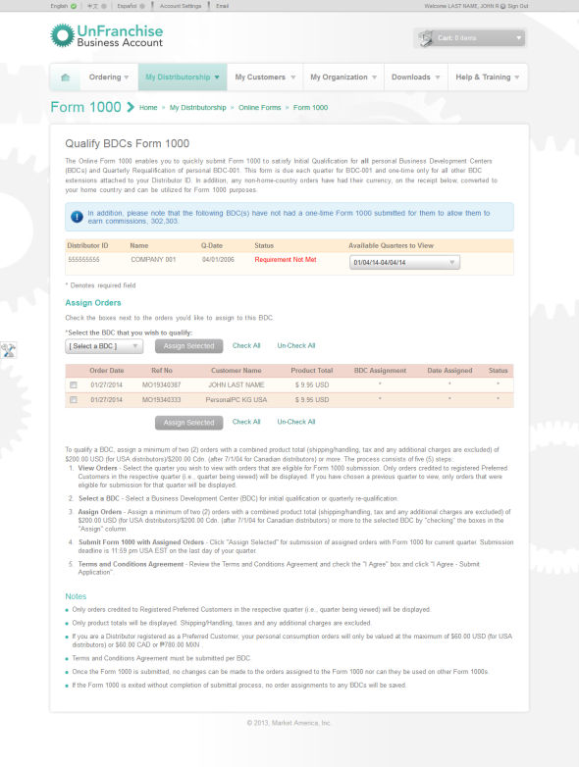
Form 1000 Update
1000 表格已更新
這是我們所有人都要做，且我們都需要去思考如何把它做得更好
多年來，我們已為1000表格增設以下措施：
電子郵件和提示，讓你知道它何時需要填寫
使經銷商更容易選擇訂單的功能
把界面盡量簡化
Something we all do and something we all need to think about
Over the years we’ve added
Emails and Alerts to let you know it needs to be filled out
Features to make it easier to select orders
Streamlining the interface as much as possible

Slide 13
Form 1000 Update
1000 表格已更新
此刻，為你帶來革命性的改變!
系統已新增每季度為001商業發展中心自動提交1000表格功能!
But now, something completely revolutionary!
Your Form 1000 will automatically submit itself each quarter for your 001 BDC!

Slide 14
它是如何運作? How Does It Work?
每晚超連鎖™事業管理系統會檢查你帳戶有沒有至少兩張零售總額已達到1000表格所要求的金額收據 (即港幣$1500)，當零售總額已達所要求的金額，系統便會針對你的 001商業發展中心自動提交你的 1000表格。
Each night the system will check to see if you have at least two receipts that total over the required amount (i.e. HK$1500), when it sees you have enough to fulfill your Form 1000 it will automatically submit your Form 1000 for your 001 with the minimum number of receipts needed.

Slide 15
它是如何運作? How Does It Work?
如果你需要針對其他商業發展中心提交 1000表格，譬如你的 002或 003，你仍需要手動呈交表格。
你仍可以手動為你的001呈交表格，注意必須比系統快
You will still need to manually submit a Form 1000 for other BDCs like you do currently (002, 301, etc)
You can still manually submit for your 001 if you like as well, you just have to be faster than the system

Slide 16
它是如何運作? How Does It Work?
系統每晚都會運作，這代表，如果你在季度的第一天已達到你的 1000表格所要求的金額收據，那麼系統就會在你季度的第一天為你001自動提交1000表格
This process runs each night, which means, if you have the receipts necessary to fulfill your Form 1000 the very first day of your quarter, then the system will submit your Form 1000 for your 001, as soon as that first day

Slide 17
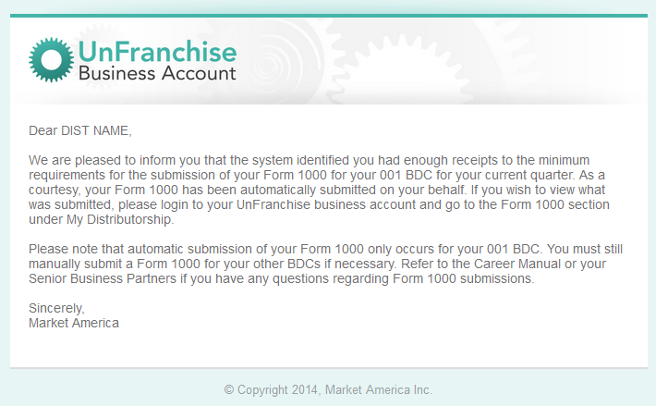
它是如何運作? How Does It Work?
最後，你將收到一封電子郵件和提示，讓你知道你001商業發展中心的1000表格已經被自動提交。
這經已推出!
Then lastly, you will receive an email and alert letting you know that your Form 1000 has been automatically submitted for your 001 BDC.
This is live!

Slide 18
化繁為簡及提升
Simplify & Improve

Slide 19
還可變得更好嗎？
Can it get any better?

Slide 20
自訂迷你網站
Custom Mini-Websites

Slide 21
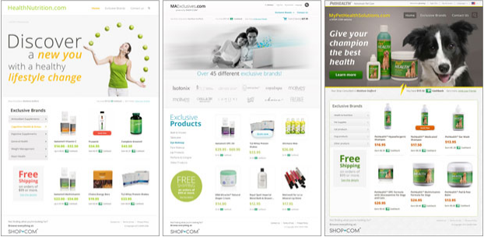
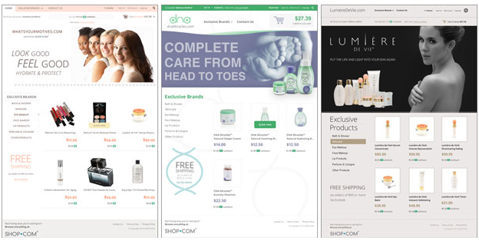
自訂迷你網站
助你獲得更多顧客並讓更多訪客進入HK.SHOP.COM
個人化網站可挑選網站的設計，選擇想展示的產品和品牌的類別，選取放置於首頁的重點產品，甚至可選取與網站相關的網域名
在開展超連鎖事業的每個市場國家，都得到該市場國家的一個免費自訂迷你網站
Custom Mini-Websites
A brand new tool to help acquire more customers and generate more traffic to HK.SHOP.COM
have the ability to pick the design of the site, choose which categories of products and brands are represented, pick which products are highlighted on the homepage, and even choose the vanity domain associated with the site
Custom Mini-Websites are country-specific, you will get one free for each market country in which your UnFranchise® Business is open for business

Slide 22
化繁為簡及提升
Simplify & Improve

Slide 23
還可變得更好嗎？
Can it get any better?

Slide 24
全新「便利提貨點」
NEW Pick Up Point Service

Slide 25
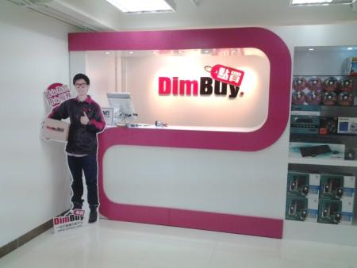
美安香港獨享
Exclusive for MHK
全新「便利提貨點」
新增設特定提貨服務點，輕鬆自由安排時間
觀塘成業街19-21號成業工業大廈7樓25室 觀塘港鐵站B1出口
灣仔軒尼詩道302-308號集成中心9樓906室 灣仔港鐵站A4出口
NEW Pick Up Point Services
Other than the existing delivery services, we have newly added two pick up points, located at Kwun Tong and Wan Chai
Unit 25, 7/F Shing Yip Industrial Building, 19-21 Shing Yip Street, Kwun Tong, Kowloon (MTR Kwun Tong Station Exit B1)
Unit 906, 9/F CC Wu Building, 302-308 Hennessy Road, Wan Chai, Hong Kong (MTR Wan Chai Station Exit A4)

Slide 26
化繁為簡及提升
Simplify & Improve

Slide 27
還可變得更好嗎？
Can it get any better?

Slide 28
超連鎖™事業教育網站
UnFranchiseTraining.com

Slide 29
We took a look at UnFranchiseTraining.com
讓我們一起看看UnFranchiseTraining.com的提升
提升方面：
品牌
分類
更易使用
已更新的內容
最新的動態消息
新類別的加入，令你更易掌握美安最新方向和動態
Ways to Improve:
Branding
Organization
Ease of use
Updated Content
Fresh Feeds
New Categories that Train on New Company Directives and Movement!

Slide 30
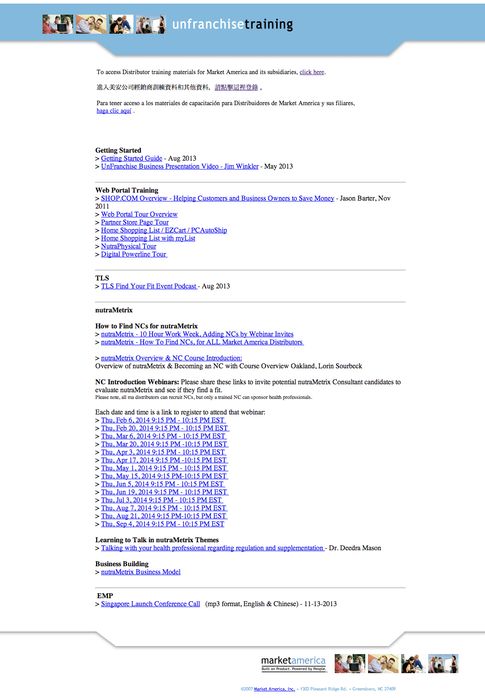
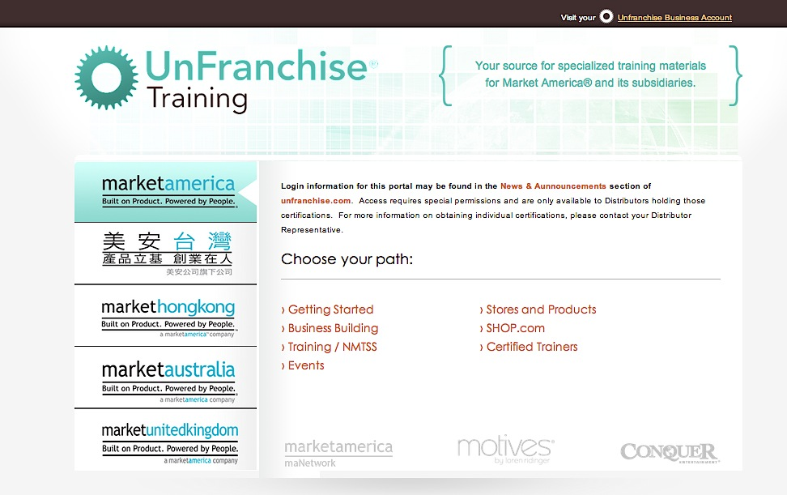
全新頁面：
品牌
自選國家
會按所選的國家而載入不同的主要瀏覽版面
獲取潛在人選的資料
超連鎖店主登入
New Home Page:
Branding
Choose Country
Main Navigation Loads based on selected country
Prospect Lead Capture
Business Owner Login

Slide 31
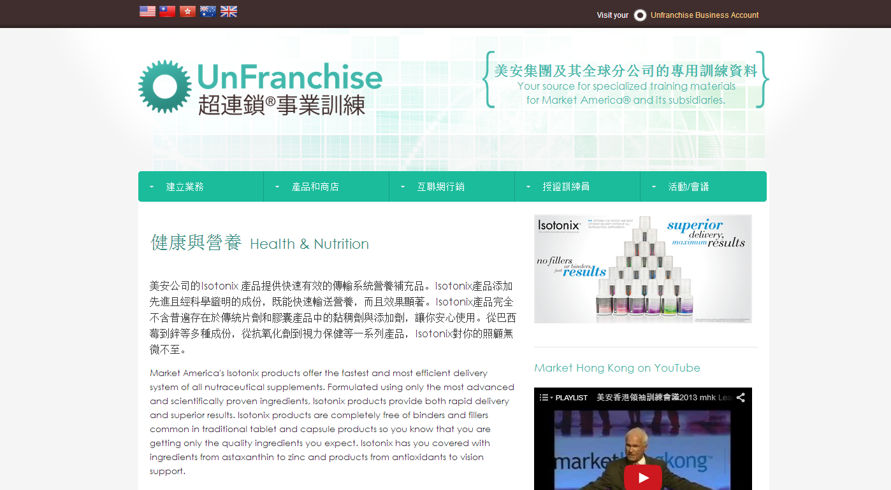
更易使用：導覽 Ease of Use: Navigation
建立業務 Business Building | 如何起步 Getting Started 業務基礎 Business Fundamentals 國際擴展 International Expansion
店舖和產品 Stores & Products | Motives 網路中心 maWebCenters 健康與營養 Health & Nutrition | TLS健康生活纖營計 其他 Other
互聯網行銷 Internet Marketing | 入門網站 HK.SHOP.COM | 互聯網行銷和訓練Internet Sales & Training
授證訓練員 Certified Trainers | 授證訓練員 Certified Trainer 網路中心授證訓練CWT Motives授證訓練MCT | TLS 教練 Trainer
活動 Events | 最近活動 Recent Events 未來活動 Upcoming Events

Slide 32
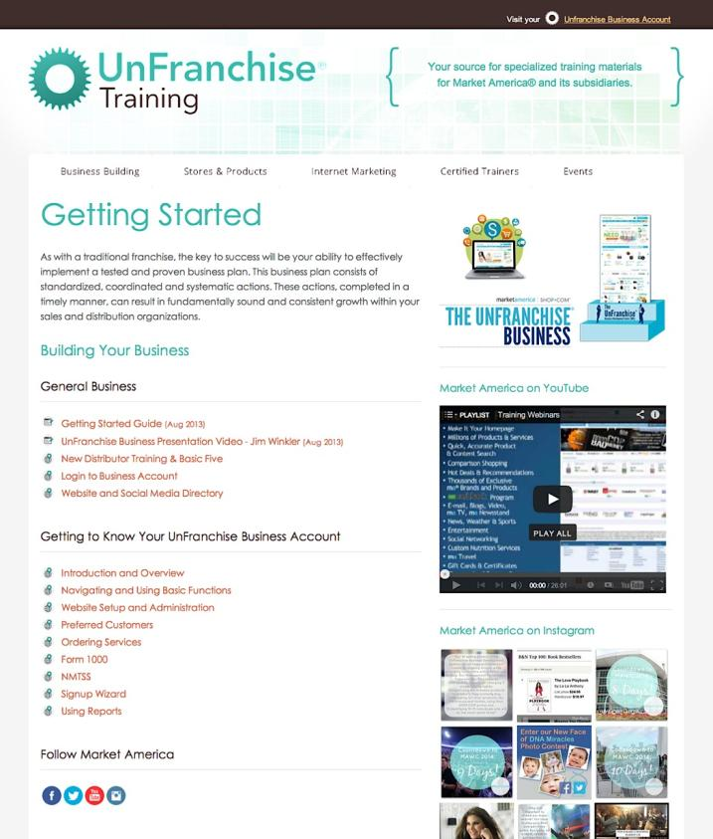
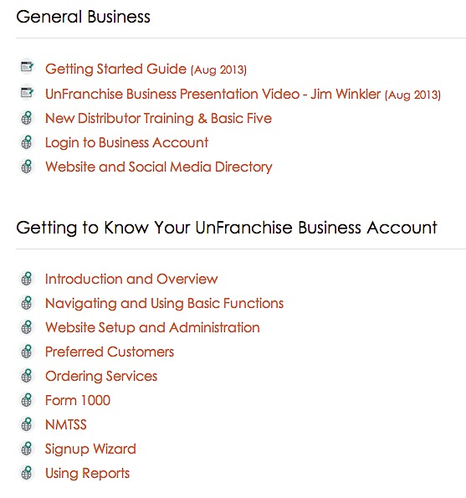
有條理，已標記，相關內容 Organized, Labeled, Relevant Content

Slide 33
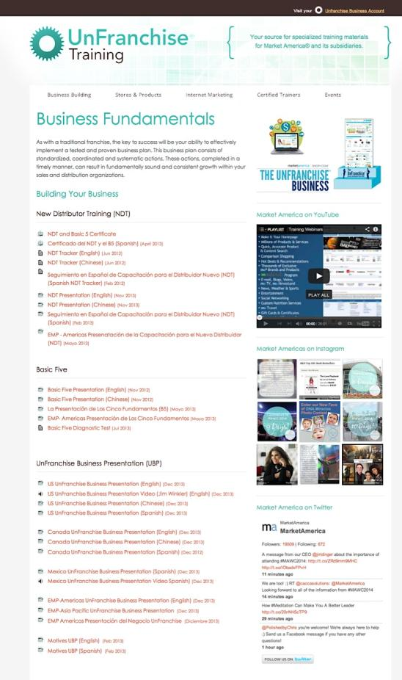
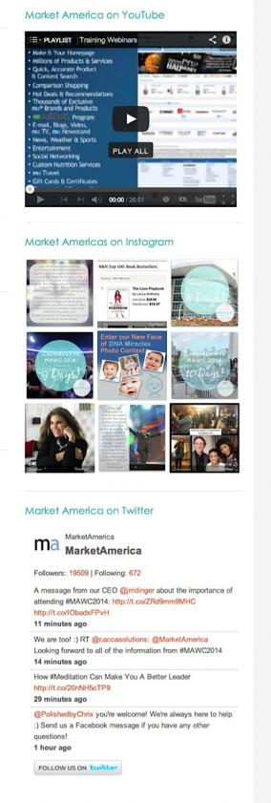
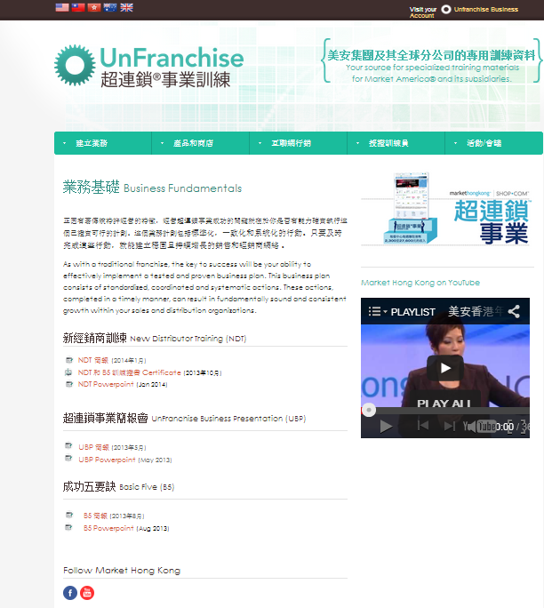
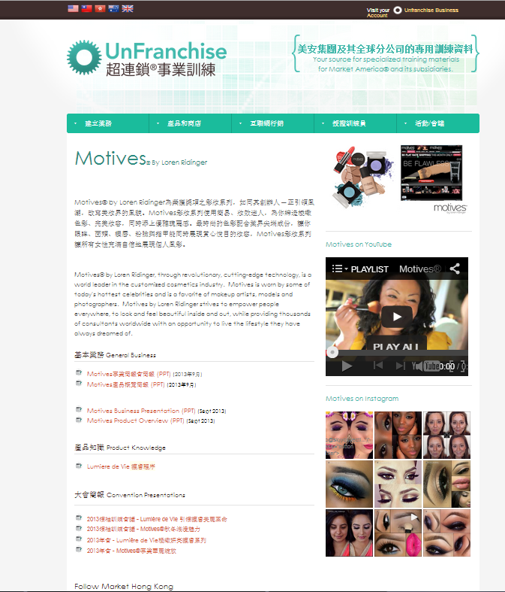
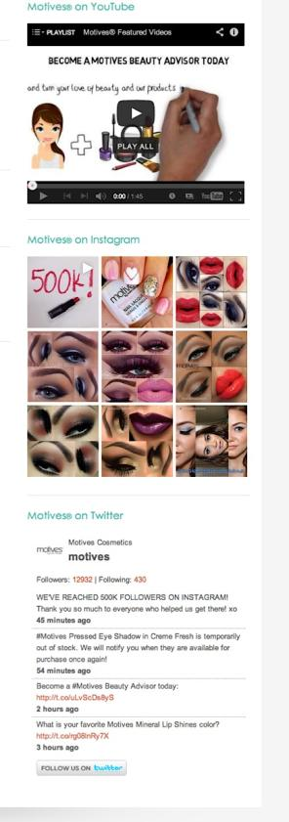
即時的社交媒體動態更新 Live Social Feeds

Slide 34
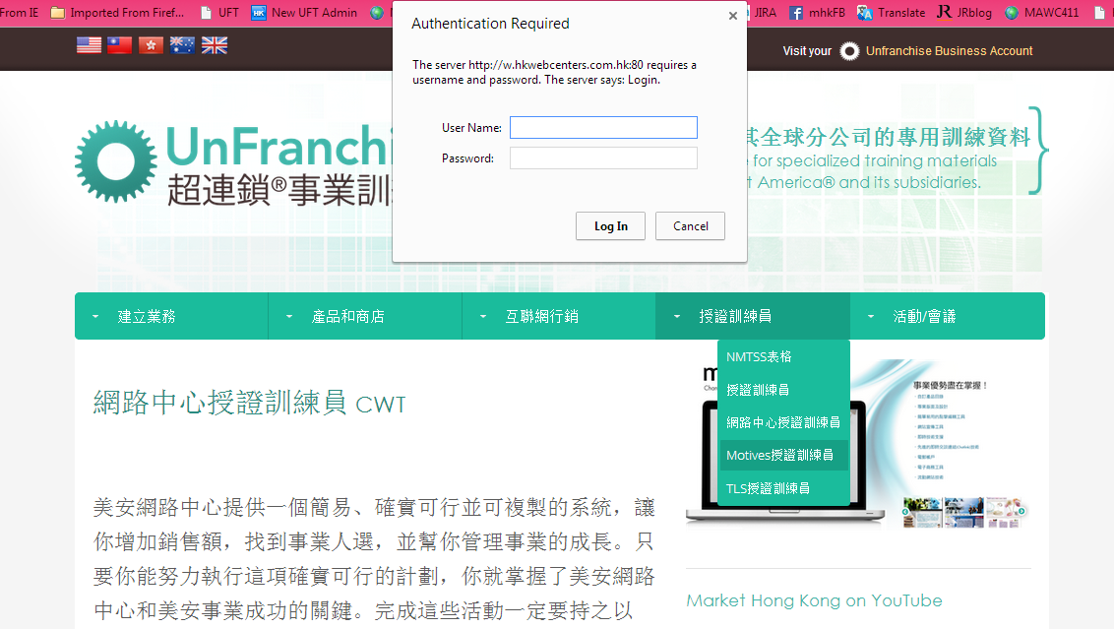
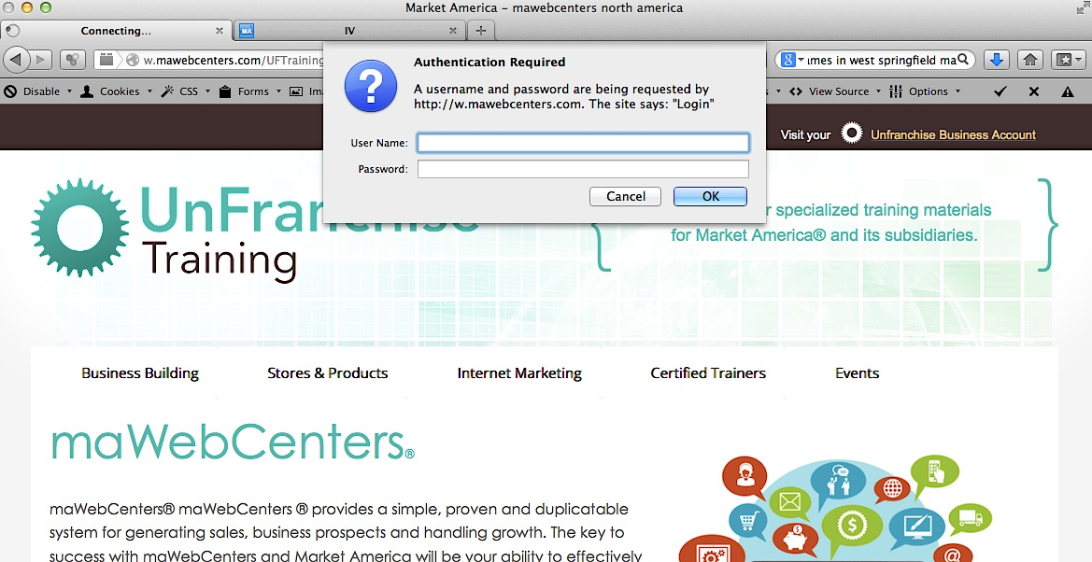
訓練員專有的密碼! Passwords for Trainers Only!

Slide 35
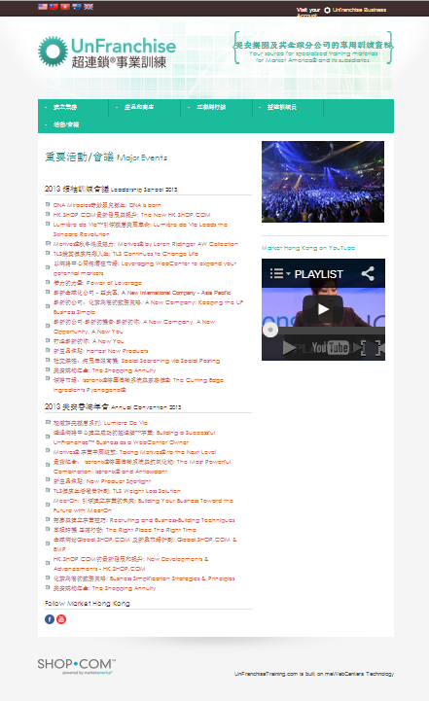
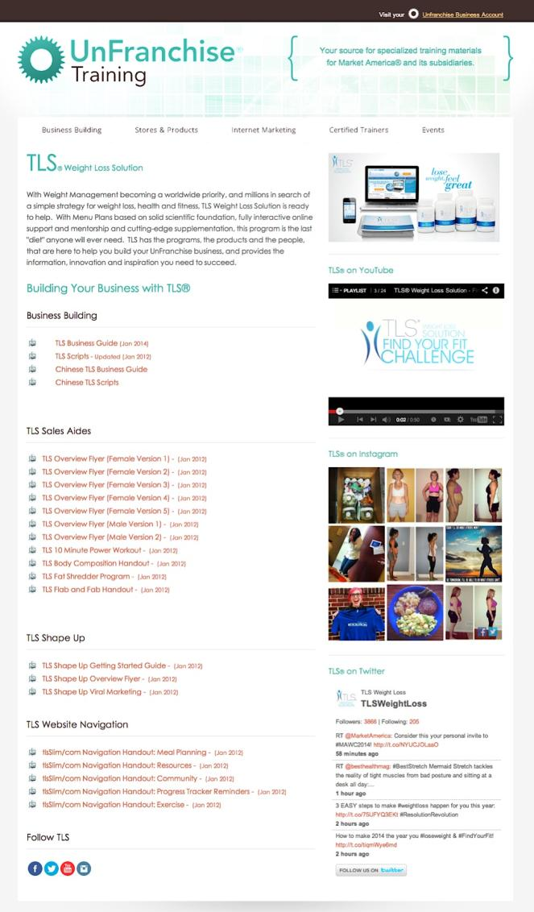

Slide 36
我希望…
I wish…

Slide 37
會議聯盟系統
NMTSS
(National Meeting, Training and Seminar System)

Slide 38
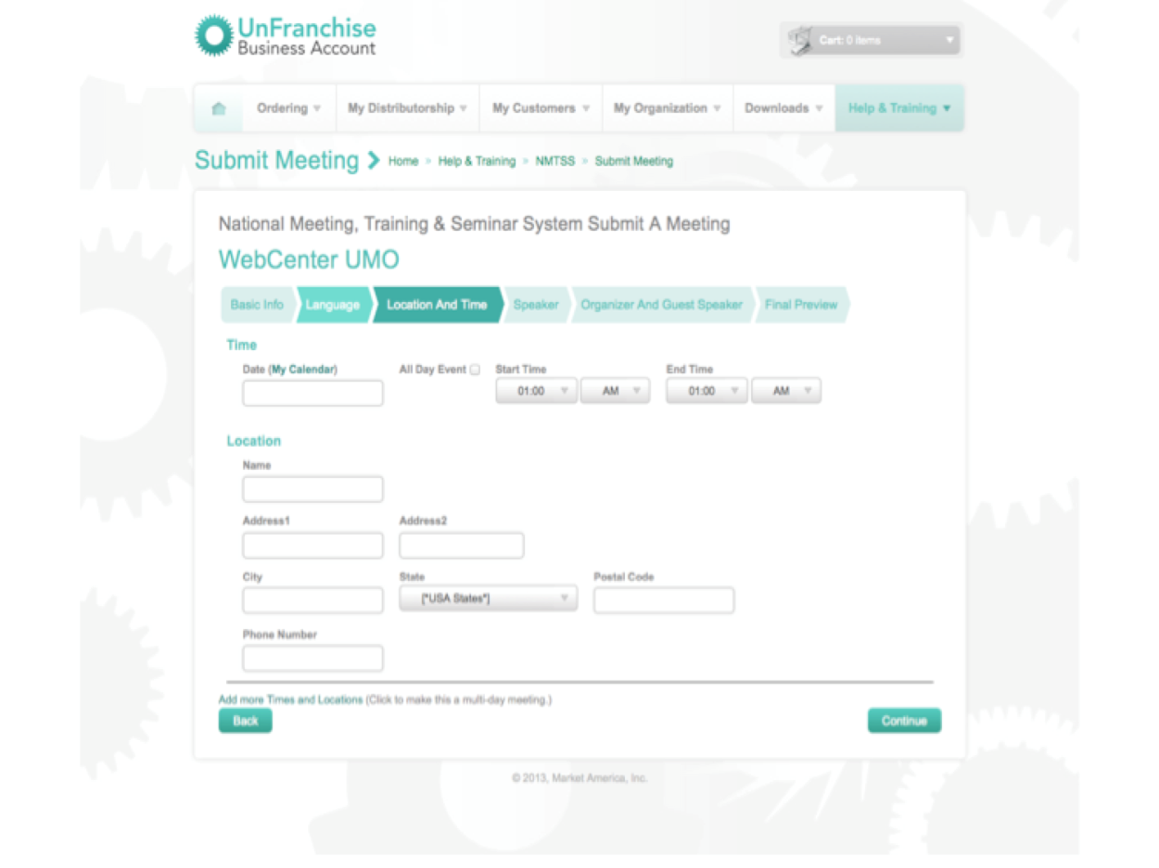
即將推出
Coming Soon
提升的會議搜尋 Improved Meeting Search

Slide 39
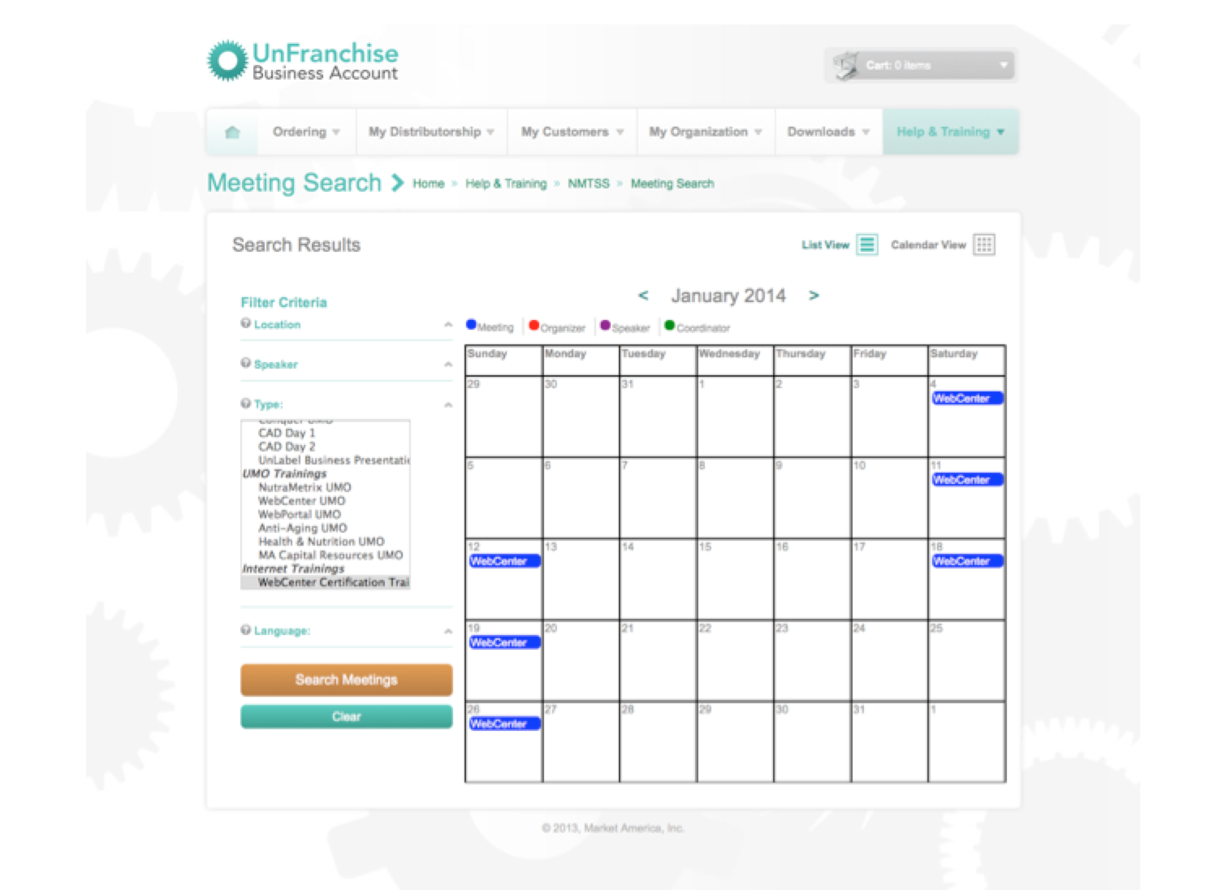
即將推出
Coming Soon
全新會議聯盟系統日曆 New NMTSS Calendar

Slide 40
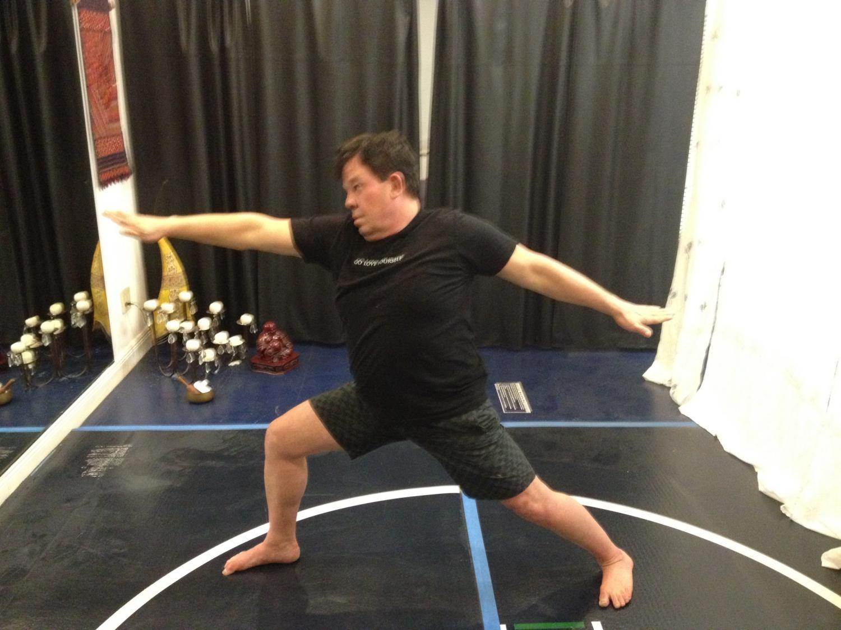
瑜珈
Yoga

Slide 41
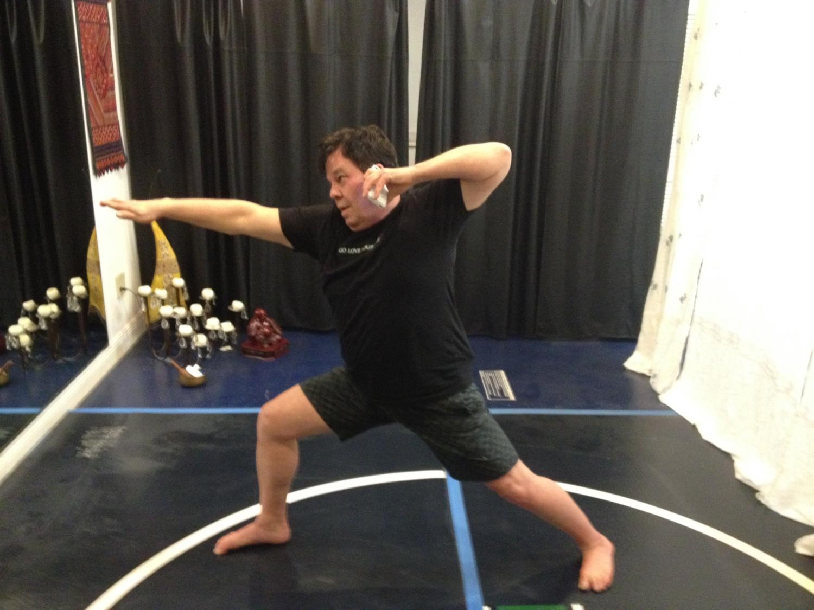
工作中
Working

Slide 42
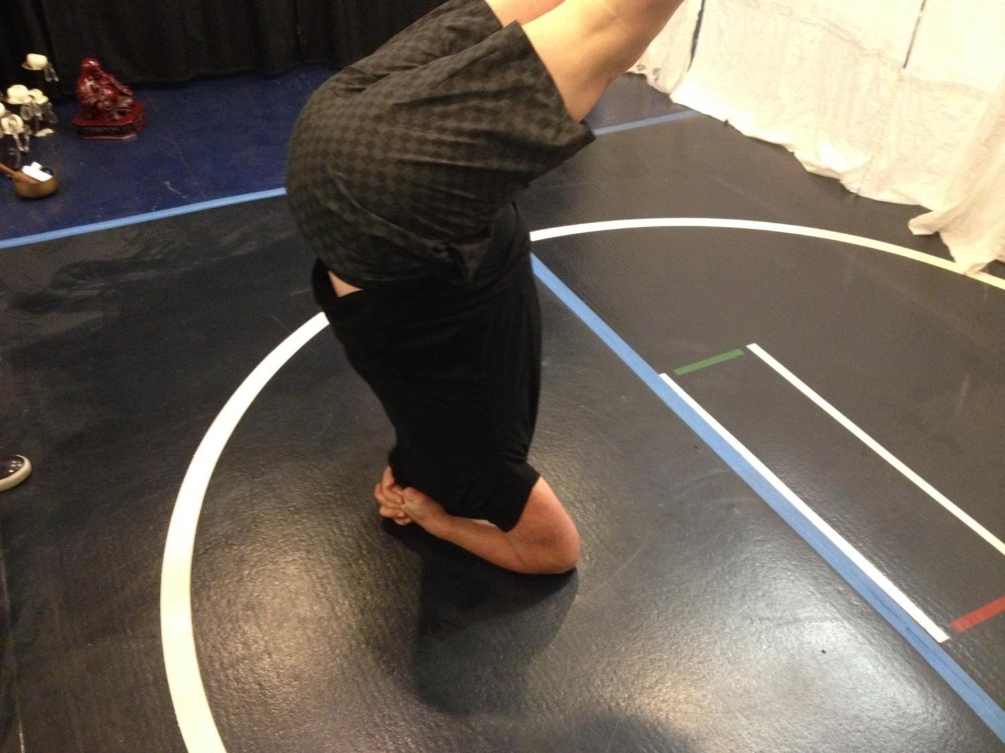
瑜珈
Yoga

Slide 43
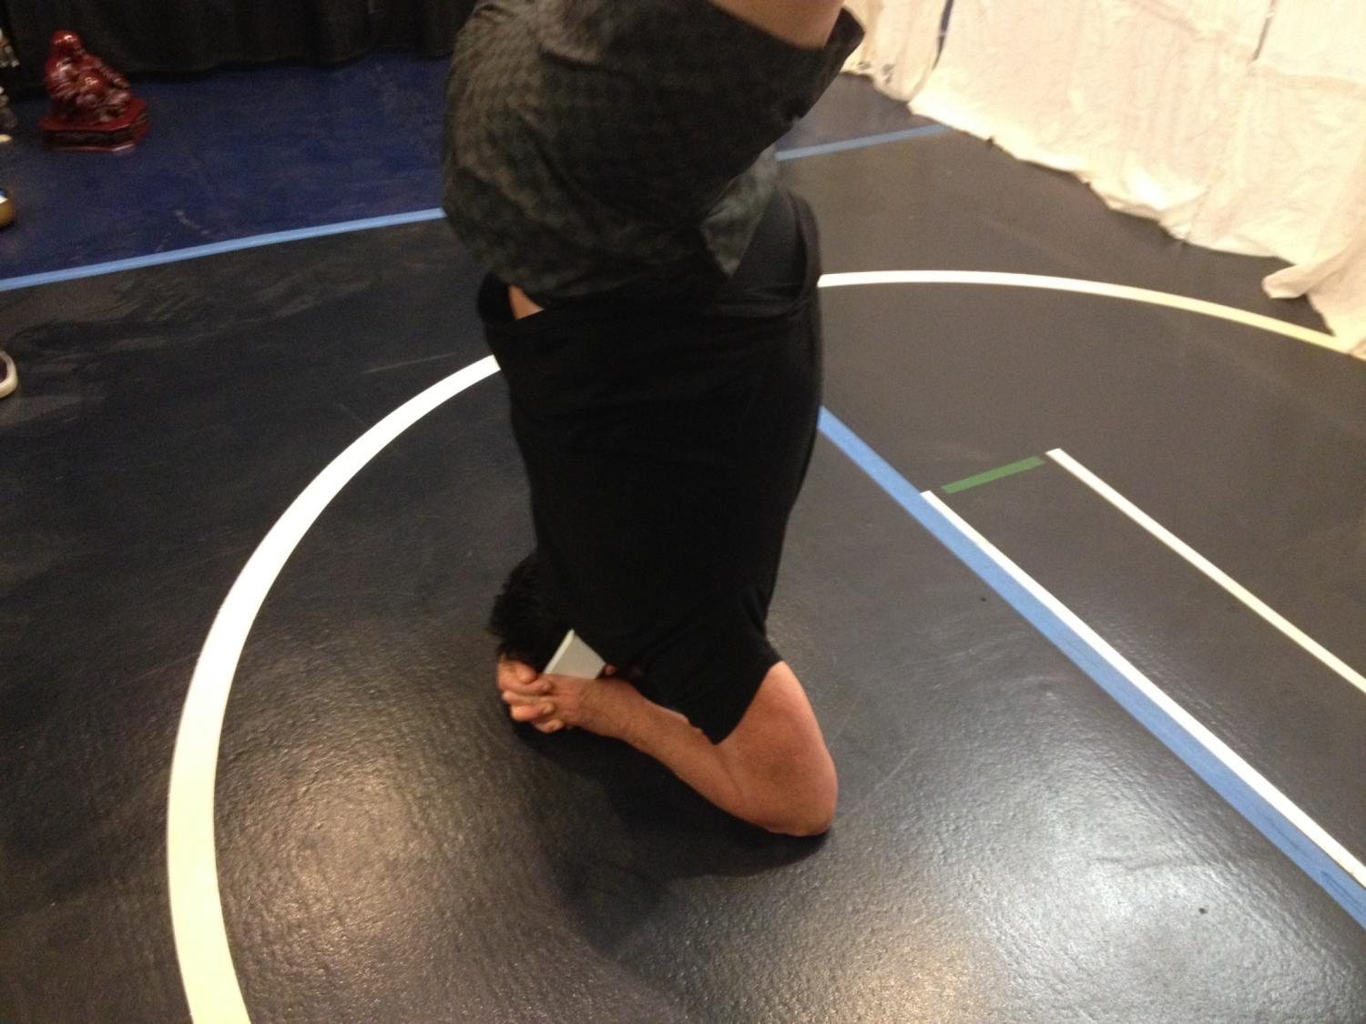
工作中
Working

Slide 44
慶祝中
Celebrating

Slide 45
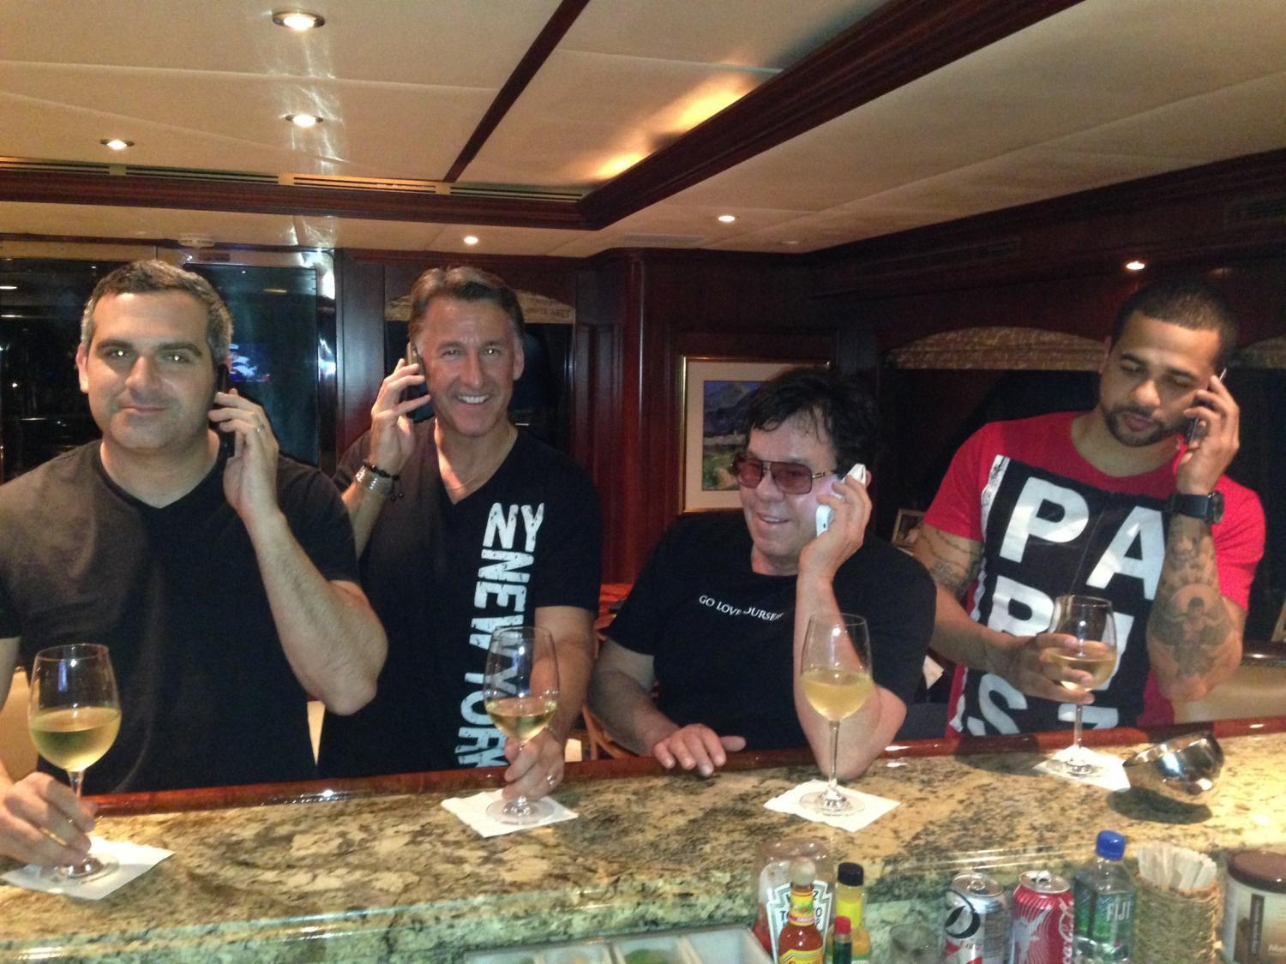
工作中
Working

Slide 46
慶祝中
Celebrating

Slide 47
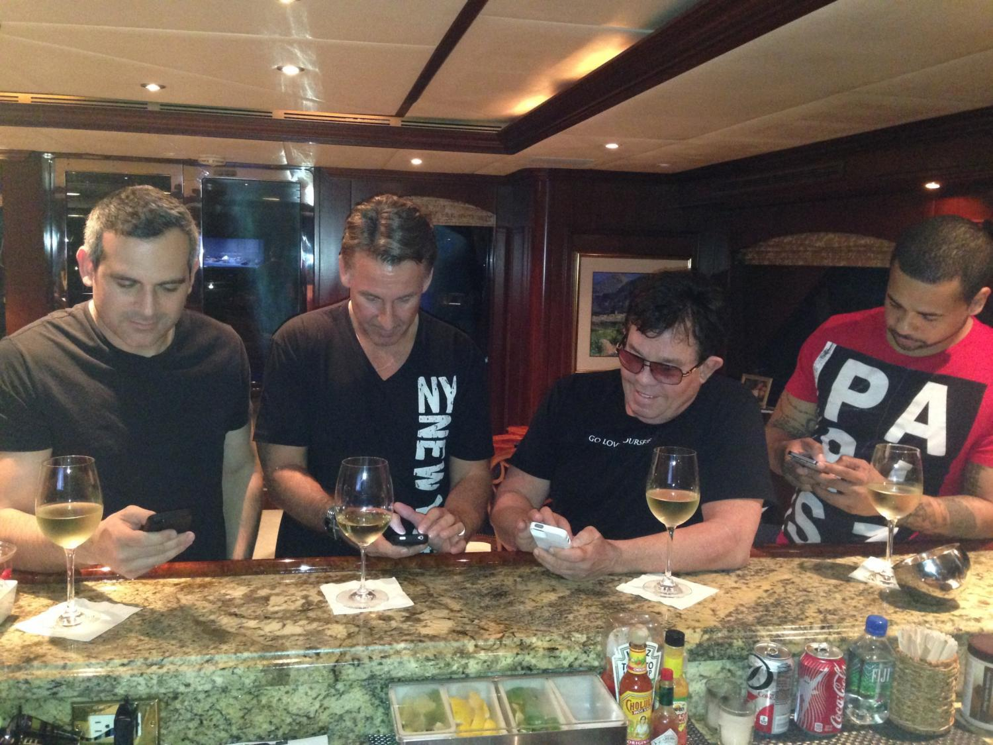
工作中
Working

Slide 48
超連鎖™事業簡報短片
UnFranchise™ Business video

Slide 49
超連鎖™事業簡報短片
超連鎖™事業簡報 (22:36)
美安香港及HK.SHOP.COM概要 (4:28)
產品分銷及互聯網行銷 (3:25)
水平行銷 v.垂直行銷 (1:35)
5個建立超連鎖™事業的步驟 (13:03)
UnFranchise™ Business video
The UnFranchise™ Business Presentation (22:36)
Market Hong Kong & HK.SHOP.COM overview (4:28)
Product Brokerage & Internet Marketing (3:25)
Horizontal v. Vertical (1:35)
Five Steps to Build an UnFranchise™ Business (13:03)

Slide 50
如何運用超連鎖™事業簡報短片
用「概要」短片作為開始介紹，社交媒體
全新9:30短片
家庭事業簡報會 (HBP)
一對一，二對一會議
跟進
How to Use the UBP videos
Use ‘Overview’ as introduction, social media
New 9:30 video
HBP
1 on 1, 2 on 1 meetings
Follow up

Slide 51
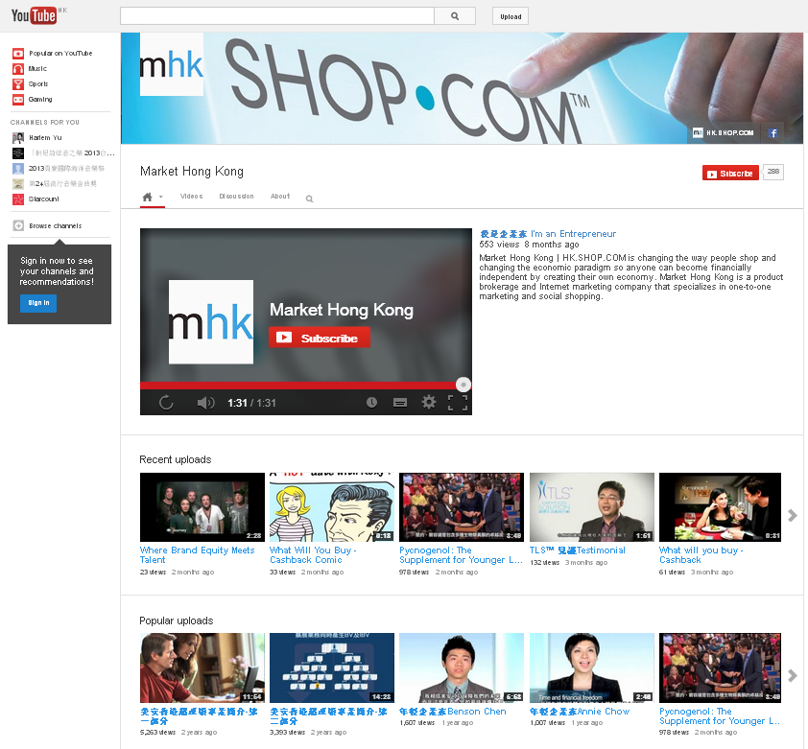
美安香港YouTube頻道：
YouTube.com/markethongkongvideos

Slide 52
超連鎖™事業簡報更新
UnFranchise™ Business Presentation
PowerPoint Update

Slide 53
Copyright © 2014 美安集團

Slide 54
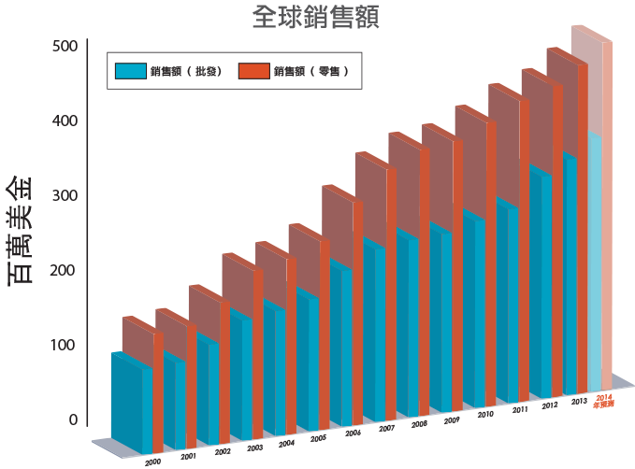
估計累積零售額 †:
US$5,548,014,051*
*從公司創立至2013年12月31日止
†估計累積零售額根據建議零售價計算
Notes:
54

Slide 55
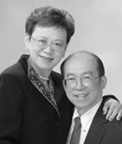
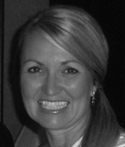
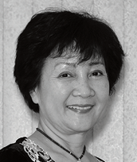
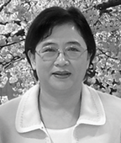
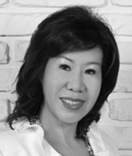
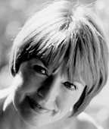
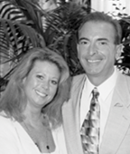
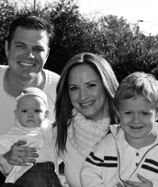
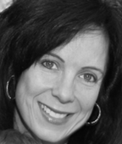
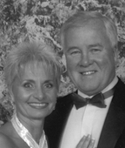
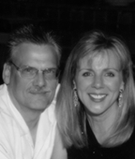
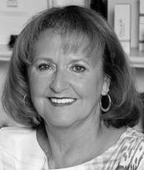
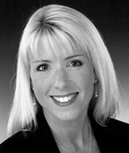
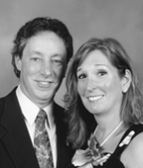
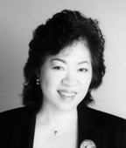
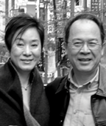
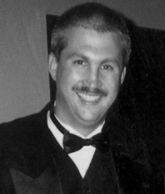
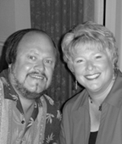
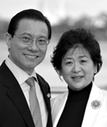
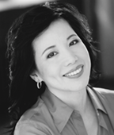
Market Hong Kong™| HK.SHOP.COM™正改變人們購物的方式，並改變經濟型態，打造我們自己的經濟，使其中每個人都能夠達到財務獨立。
估計總零售利潤†:
US$1,493,417,364
+
總佣金: US$1,474,397,101
=
經銷商總收入: US$2,967,814,465*
*截至2013年12月31日止，估計零售利潤根據建議零售價計算
本簡報中提到的收入等級純屬舉例說明，無意代表美安香港經銷商的一般收入，也無意表示任何經銷商皆可賺取同等收入。美安香港經銷商的成功與否，取決於其在發展事業時的努力、才能與投入程度。The income levels mentioned in the following presentation are for illustration purposes only. They are not intended to represent the income of a typical Market Hong Kong Distributor, nor are they intended to represent that any given Independent Distributor will earn income in that amount. The success of any Market Hong Kong Independent Distributor will depend upon the amount of hard work, talent, and dedication which he or she devotes to building his or her Market Hong Kong Business.

Slide 60
嬰幼兒護理

Slide 61
嬰幼兒護理

Slide 62
熱門優惠
數百項美安獨家品牌產品
社交網絡
購買美安品牌的產品和上有現金回贈圖示的夥伴商店產品，賺取高達25%的現金回贈 。
推薦他人購物，從被推薦人的消費中賺取0.5%的現金回贈 。

Slide 63
夥伴商店
夥伴商店
夥伴商店
夥伴商店

Slide 65
化繁為簡及提升
Simplify & Improve

Slide 66
產品組合套裝
Product Packages

Slide 67
Lumière de Vie® 極緻妍亮尊貴組合
Lumière de Vie®
極緻妍亮基本組合
SAVE
28%
TLS® WEIGHT LOSS SOLUTION KIT
纖營修身套裝

Slide 68
SAVE
33%
SAVE
32%
高效營養組合
Optimal Wellness Kit
Isotonix®基本營養組合
Isotonix® Daily Essentials Kit
SAVE
25%
SAVE
24%
精叻兒童系列－至「營」iKids套裝
Might-A-Mins Spectrum-
iKids Nutrition Combo
全方位DETOX纖營組合
Complete Cleansing and
Detoxification Kit

Slide 69
UF.com 超連鎖™管理系統
產品資訊單張
常見問題單張
海報
Motives® 產品目錄
鋪售輔助工具
產品宣傳單張
護膚程序單張

Slide 70
下載–健康與營養及其他產品–宣傳單張
Downloads – Health & Nutrition and other products – Flyer

Slide 71
宣傳電郵
Promotional Email
新產品推出
New product launch
每月精選產品
Monthly featured product

Slide 72
宣傳電郵 Promotional Email

Slide 73
化繁為簡及提升
Simplify & Improve

Slide 74
總裁挑戰賽的發起人為美安集團主席及行政總裁 JR Ridinger (JR)
THE PRESIDENT’S CHALLENGE
is issued by President and CEO...
JR Ridinger

Slide 75
1
成為正式的主管超連鎖™店主或使你的主管超連鎖™店主資格再次合格。
Satisfy the UnFranchise™ Owner (UFO) criteria or re-qualify as a UFO.

Slide 76
2
個人推薦 6 位新的合格超連鎖™店主，並使其中 1 位個人推薦 2 位合格超連鎖™店主（擴展業務）。
Personally sponsor six new qualified distributors, and have one of your new personally sponsored distributors personally sponsored 2 new qualified distributors.

Slide 77
3
直接向美安香港購買 10 張 2014 美安香港領袖訓練會議的門票。
Purchase 10 tickets to Market Hong Kong’s Leadership School 2014.

Slide 78
4
符合列出之要求以獲得「宣傳獎賞庫」獎賞。
Satisfy the criteria to qualify for the Advertising Bonus Pool.
要求詳請須參閱申請表格
Requirement details refer to the application form

Slide 79
5
至少有五位顧客從你的入門網站上購物（購自美安香港及／或一間夥伴商店）。
Have at least five customers purchase through your web portal (from Market Hong Kong and/or from a partner store).

Slide 80
2014 美安香港領袖訓練會議總裁挑戰賽
2014 年 3 月 29 日至 9 月 26 日
Leadership School 2014 President’s Challenge
Mar 29 - Sep 26, 2014
立即購票
領袖訓練會議
九龍灣國際展貿中心
2014年11月14至16日

Slide 81
嶄新的公司，嶄新的機會，嶄新的你
2014美安香港年會
mhk Annual Convention
#MHKAC2014

